Slide 1
Topic IP Routing Technologies
CCNA Routing and Switching
200-120 Examination
Jeng-Yueng Chen
Hsiuping University of Science and Technology

Slide 2
126

Slide 3
127

Slide 4
128

Slide 5
129
Which parameter or parameters are used to calculate OSPF cost in Cisco routers?
Bandwidth
Bandwidth and Delay
Bandwidth, Delay, and MTU
Bandwidth, MTU, Reliability, Delay, and Load

Slide 6
130
Why do large OSPF networks use a hierarchical design? (Choose three.)
to decrease latency by increasing bandwidth
to reduce routing overhead
to speed up convergence
to confine network instability to single areas of the network
to reduce the complexity of router configuration
to lower costs by replacing routers with distribution layer switches

Slide 7
131
Which command encrypts all plaintext passwords?
Router# service password-encryption
Router(config)# password-encryption
Router(config)# service password-encryption
Router# password-encryption

Slide 8
132
Which two are advantages of static routing when compared to dynamic routing? (Choose two.)
Configuration complexity decreases as network size increases.
Security increases because only the network administrator may change the routing table.
Route summarization is computed automatically by the router.
Routing tables adapt automatically to topology changes.
An efficient algorithm is used to build routing tables, using automatic updates.
Routing updates are automatically sent to neighbors.
Routing traffic load is reduced when used in stub network links.

Slide 9
133
A network administrator needs to allow only one Telnet connection to a router. For anyone viewing the configuration and issuing the show run command, the password for Telnet access should be encrypted. Which set of commands will accomplish this task?
service password-encryption
access-list 1 permit 192.168.1.0 0.0.0.255
line vty 0 4
login
password cisco
access-class 1
enable password secret
line vty 0
login
password cisco
service password-encryption
line vty 1
login
password cisco
service password-encryption
line vty 0 4
login
password cisco

Slide 10
134
Refer to the exhibit. The speed of all serial links is E1 and the speed of all Ethernet links is 100 Mb/s. A static route will be established on the Manchester router to direct traffic toward the Internet over the most direct path available. What configuration on the Manchester router will establish a route toward the Internet for traffic that originates from workstations on the Manchester LAN?

Slide 11
134
ip route 0.0.0.0 255.255.255.0 172.16.100.2
ip route 0.0.0.0 0.0.0.0 128.107.1.1
ip route 0.0.0.0 255.255.255.252 128.107.1.1
ip route 0.0.0.0 0.0.0.0 172.16.100.1
ip route 0.0.0.0 0.0.0.0 172.16.100.2
ip route 0.0.0.0 255.255.255.255 172.16.100.2

Slide 12
135
Refer to the exhibit. The network administrator must establish a route by which London workstations can forward traffic to the Manchester workstations. What is the simplest way to accomplish this?

Slide 13
135
Configure a dynamic routing protocol on London to advertise all routes to Manchester.
Configure a dynamic routing protocol on London to advertise summarized routes to Manchester.
Configure a dynamic routing protocol on Manchester to advertise a default route to the London router.
Configure a static default route on London with a next hop of 10.1.1.1.
Configure a static route on London to direct all traffic destined for 172.16.0.0/22 to 10.1.1.2.
Configure Manchester to advertise a static default route to London.

Slide 14
136
Refer to the exhibit. The network administrator requires easy configuration options and minimal routing protocol traffic. What two options provide adequate routing table information for traffic that passes between the two routers and satisfy the requests of the network administrator? (Choose two.)

Slide 15
136
a dynamic routing protocol on InternetRouter to advertise all routes to CentralRouter.
a dynamic routing protocol on InternetRouter to advertise summarized routes to CentralRouter.
a static route on InternetRouter to direct traffic that is destined for 172.16.0.0/16 to CentralRouter.
a dynamic routing protocol on CentralRouter to advertise all routes to InternetRouter.
a dynamic routing protocol on CentralRouter to advertise summarized routes to InternetRouter.
a static, default route on CentralRouter that directs traffic to InternetRouter.

Slide 16
137
What is the effect of using the service password-encryption command?
Only the enable password will be encrypted.
Only the enable secret password will be encrypted.
Only passwords configured after the command has been entered will be encrypted.
It will encrypt the secret password and remove the enable secret password from the configuration.
It will encrypt all current and future passwords.

Slide 17
138
Refer to the exhibit. What is the effect of the configuration that is shown?
It configures SSH globally for all logins.
It tells the router or switch to try to establish an SSh connection first and if that fails to use Telnet.
It configures the virtual terminal lines with the password 030752180500.
It configures a Cisco network device to use the SSH protocol on incoming communications via the virtual terminal ports.
It allows seven failed login attempts before the VTY lines are temporarily shutdown.

Slide 18
139
Refer to the exhibit. What is the reason that the interface status is "administratively down, line protocol down"?
There is no encapsulation type configured.
There is a mismatch in encapsulation types.
The interface is not receiving any keepalives.
The interface has been configured with the shutdown command.
The interface needs to be configured as a DTE device.
The wrong type of cable is connected to the interface.

Slide 19
140
Refer to the exhibit. When running OSPF, what would cause router A not to form an adjacency with router B?
The loopback addresses are on different subnets.
The values of the dead timers on the routers are different.
Route summarization is enabled on both routers.
The process identifier on router A is different than the process identifier on router B.

Slide 20
141
A router has learned three possible routes that could be used to reach a destination network. One route is from EIGRP and has a composite metric of 20514560. Another route is from OSPF with a metric of 782. The last is from RIPv2 and has a metric of 4. Which route or routes will the router install in the routing table?
the OSPF route
the EIGRP route
the RIPv2 route
all three routes
the OSPF and RIPv2 routes

Slide 21
142
Refer to the exhibit. The company uses EIGRP as the routing protocol. What path will packets take from a host on the 192.168.10.192/26 network to a host on the LAN attached to router R1?

Slide 22
142
The path of the packets will be R3 to R2 to R1.
The path of the packets will be R3 to R1 to R2.
The path of the packets will be both R3 to R2 to R1 AND R3 to R1.
The path of the packets will be R3 to R1

Slide 23
143
A network administrator is troubleshooting an EIGRP problem on a router and needs to confirm the IP addresses of the devices with which the router has established adjacency. The retransmit interval and the queue counts for the adjacent routers also need to be checked. What command will display the required information?
Router# show ip eigrp adjacency
Router# show ip eigrp topology
Router# show ip eigrp interfaces
Router# show ip eigrp neighbors

Slide 24
144
Refer to the graphic. R1 is unable to establish an OSPF neighbor relationship with R3. What are possible reasons for this problem? (Choose two.)

Slide 25
144
All of the routers need to be configured for backbone Area 1.
R1 and R2 are the DR and BDR, so OSPF will not establish neighbor adjacency with R3.
A static route has been configured from R1 to R3 and prevents the neighbor adjacency from being established.
The hello and dead interval timers are not set to the same values on R1 and R3.
EIGRP is also configured on these routers with a lower administrative distance.
R1 and R3 are configured in different areas.

Slide 26
145
What is a global command?
a command that is set once and affects the entire router
a command that is implemented in all foreign and domestic IOS versions
a command that is universal in application and supports all protocols
a command that is available in every release of IOS, regardless of the version or deployment status
a command that can be entered in any configuration mode

Slide 27
146
Refer to the exhibit. When running EIGRP, what is required for RouterA to exchange routing updates with RouterC?
AS numbers must be changed to match on all the routers
Loopback interfaces must be configured so a DR is elected
The no auto-summary command is needed on Router A and Router C
Router B needs to have two network statements, one for each connected network

Slide 28
147
A Cisco router is booting and has just completed the POST process. It is now ready to find and load an IOS image. What function does the router perform next?
It checks the configuration register.
It attempts to boot from a TFTP server.
It loads the first image file in flash memory.
It inspects the configuration file in NVRAM for boot instructions.

Slide 29
148
Refer to the exhibit. What is the meaning of the output MTU 1500 bytes?
The maximum number of bytes that can traverse this interface per second is 1500.
The minimum segment size that can traverse this interface is 1500 bytes.
The maximum segment size that can traverse this interface is 1500 bytes.
The minimum packet size that can traverse this interface is 1500 bytes.
The maximum packet size that can traverse this interface is 1500 bytes.
The maximum frame size that can traverse this interface is 1500 bytes.

Slide 30
149
On a corporate network, hosts on the same VLAN can communicate with each other, but they are unable to communicate with hosts on different VLANs. What is needed to allow communication between the VLANs?
a router with subinterfaces configured on the physical interface that is connected to the switch
a router with an IP address on the physical interface connected to the switch
a switch with an access link that is configured between the switches
a switch with a trunk link that is configured between the switches

Slide 31
150
Which command displays CPU utilization?
show protocols
show process
show system
show version

Slide 32
151
What two things will a router do when running a distance vector routing protocol? (Choose two.)
Send periodic updates regardless of topology changes.
Send entire routing table to all routers in the routing domain.
Use the shortest-path algorithm to the determine best path.
Update the routing table based on updates from their neighbors.
Maintain the topology of the entire network in its database.

Slide 33
152
Which command is used to display the collection of OSPF link states?
show ip ospf link-state
show ip ospf lsa database
show ip ospf neighbors
show ip ospf database

Slide 34
153
Refer to the exhibit. The technician wants to upload a new IOS in the router while keeping the existing IOS. What is the maximum size of an IOS file that could be loaded if the original IOS is also kept in flash?
3 MB
4 MB
5 MB
7 MB
8 MB

Slide 35
154
Refer to the exhibit. The two exhibited devices are the only Cisco devices on the network. The serial network between the two devices has a mask of 255.255.255.252. Given the output that is shown, what three statements are true of these devices? (Choose three.)

Slide 36
154
The Manchester serial address is 10.1.1.1.
The Manchester serial address is 10.1.1.2.
The London router is a Cisco 2610.
The Manchester router is a Cisco 2610.
The CDP information was received on port Serial0/0 of the Manchester router.
The CDP information was sent by port Serial0/0 of the London router.

Slide 37
155
If IP routing is enabled, which two commands set the gateway of last resort to the default gateway? (Choose two.)
ip default-gateway 0.0.0.0
ip route 172.16.2.1 0.0.0.0 0.0.0.0
ip default-network 0.0.0.0
ip default-route 0.0.0.0 0.0.0.0 172.16.2.1
ip route 0.0.0.0 0.0.0.0 172.16.2.1

Slide 38
156
Which parameter would you tune to affect the selection of a static route as a backup, when a dynamic protocol is also being used?
hop count
administrative distance
link bandwidth
link delay
link cost

Slide 39
157
Refer to the exhibit. A network associate has configured OSPF with the command:
City(config-router)# network 192.168.12.64 0.0.0.63 area 0
After completing the configuration, the associate discovers that not all the interfaces are participating in OSPF. Which three of the interfaces shown in the exhibit will participate in OSPF according to this configuration statement? (Choose three.)
FastEthernet0 /0
FastEthernet0 /1
Serial0/0
Serial0/1.102
Serial0/1.103
Serial0/1.104

Slide 40
158
Refer to the exhibit. The Lakeside Company has the internetwork in the exhibit. The administrator would like to reduce the size of the routing table on the Central router. Which partial routing table entry in the Central router represents a route summary that represents the LANs in Phoenix but no additional subnets?

Slide 41
158
10.0.0.0/22 is subnetted, 1 subnets
D 10.0.0.0 [90/20514560] via 10.2.0.2, 6w0d, Serial0/1
10.0.0.0/28 is subnetted, 1 subnets
D 10.2.0.0 [90/20514560] via 10.2.0.2, 6w0d, Serial0/1
10.0.0.0/30 is subnetted, 1 subnets
D 10.2.2.0 [90/20514560] via 10.2.0.2, 6w0d, Serial0/1
10.0.0.0/22 is subnetted, 1 subnets
D 10.4.0.0 [90/20514560] via 10.2.0.2, 6w0d, Serial0/1
10.0.0.0/28 is subnetted, 1 subnets
D 10.4.4.0 [90/20514560] via 10.2.0.2, 6w0d, Serial0/1
10.0.0.0/30 is subnetted, 1 subnets
D 10.4.4.4 [90/20514560] via 10.2.0.2, 6w0d, Serial0/1

Slide 42
159
Refer to the graphic. A static route to the 10.5.6.0/24 network is to be configured on the HFD router. Which commands will accomplish this? (Choose two.)
HFD(config)# ip route 10.5.6.0 0.0.0.255 fa0/0
HFD(config)# ip route 10.5.6.0 0.0.0.255 10.5.4.6
HFD(config)# ip route 10.5.6.0 255.255.255.0 fa0/0
HFD(config)# ip route 10.5.6.0 255.255.255.0 10.5.4.6
HFD(config)# ip route 10.5.4.6 0.0.0.255 10.5.6.0
HFD(config)# ip route 10.5.4.6 255.255.255.0 10.5.6.0

Slide 43
160
Before installing a new, upgraded version of the IOS, what should be checked on the router, and which command should be used to gather this information? (Choose two.)
the amount of available ROM
the amount of available flash and RAM memory
the version of the bootstrap software present on the router
show version
show processes
show running-config

Slide 44
161
Which command reveals the last method used to powercycle a router?
show reload
show boot
show running-config
show version

Slide 45
162
Which command would you use on a Cisco router to verify the Layer 3 path to a host?
tracert address
traceroute address
telnet address
ssh address

Slide 46
163
What information does a router running a link-state protocol use to build and maintain its topological database? (Choose two.)
hello packets
SAP messages sent by other routers
LSAs from other routers
beacons received on point-to-point links
routing tables received from other link-state routers
TTL packets from designated routers

Slide 47
164
Which statements describe the routing protocol OSPF? (Choose three.)
It supports VLSM.
It is used to route between autonomous systems.
It confines network instability to one area of the network.
It increases routing overhead on the network.
It allows extensive control of routing updates.
It is simpler to configure than RIP v2.
Notes:
Ospf features:
i. Can use VLSM
ii. Converges quickly
iii. Uses the concept of areas which helps for route summarization
iv. Allows authentication
v. Uses Dijkstra’s algorithm (SPF Algorithm)
vi. Reduces the usage of bandwidth (BW) by sending triggered updates to announce changes in the network
vii. Sending periodic updates 30min interval. Uses short Hello messages on a short regular interval, with the absence of hello messages indicating that a neighbor is no longer reachable.
Finally, to confine network instability to one area of the network, OSPF uses router ID or a 32-bit IP address selected at the beginning of the OSPF process. The highest IP address configured on the router is the router ID. If a loopback address is configured, then it is the router ID. In case of multiple loopback addresses, the highest loopback address is the router ID. Once the router ID is elected it doesn't change unless the IP address is removed or OSPF restarts.
- See more at: http://www.orbitco-ccna-pastquestions.com/Cisco-CCNA%3A-OSPF-Questions.php#sthash.8bf2mku2.dpuf

Slide 48
165
Refer to the exhibit. A network administrator configures a new router and enters the copy startup-config running-config command on the router. The network administrator powers down the router and sets it up at a remote location. When the router starts, it enters the system configuration dialog as shown. What is the cause of the problem?
The network administrator failed to save the configuration.
The configuration register is set to 0x2100.
The boot system flash command is missing from the configuration.
The configuration register is set to 0x2102.
The router is configured with the boot system startup command.

Slide 49
166
What is the default administrative distance of OSPF?
90
100
110
120

Slide 50
167
Which characteristics are representative of a link-state routing protocol? (Choose three.)
provides common view of entire topology
exchanges routing tables with neighbors
calculates shortest path
utilizes event-triggered updates
utilizes frequent periodic updates

Slide 51
168
Refer to the exhibit. Based on the exhibited routing table, how will packets from a host within the 192.168.10.192/26 LAN be forwarded to 192.168.10.1?

Slide 52
168
The router will forward packets from R3 to R2 to R1.
The router will forward packets from R3 to R1 to R2.
The router will forward packets from R3 to R2 to R1 AND from R3 to R1.
The router will forward packets from R3 to R1.

Slide 53
169
Refer to the exhibit. C-router is to be used as a "router-on-a-stick" to route between the VLANs. All the interfaces have been properly configured and IP routing is operational. The hosts in the VLANs have been configured with the appropriate default gateway. What is true about this configuration?

Slide 54
169
These commands need to be added to the configuration:
C-router(config)# router eigrp 123
C-router(config-router)# network 172.19.0.0
These commands need to be added to the configuration:
C-router(config)# router ospf 1
C-router(config-router)# network 172.19.0.0 0.0.3.255 area 0
These commands need to be added to the configuration:
C-router(config)# router rip
C-router(config-router)# network 172.19.0.0
No further routing configuration is required.

Slide 55
170
Refer to the exhibit. Why is flash memory erased prior to upgrading the IOS image from the TFTP server?

Slide 56
170
The router cannot verify that the Cisco IOS image currently in flash is valid.
Flash memory on Cisco routers can contain only a single IOS image.
Erasing current flash content is requested during the copy dialog.
In order for the router to use the new image as the default, it must be the only IOS image in flash.

Slide 57
171
Which command would you configure globally on a Cisco router that would allow you to view directly connected Cisco devices?
enable cdp
cdp enable
cdp run
run cdp

Slide 58
172
Refer to the exhibit. According to the routing table, where will the router send a packet destined for 10.1.5.65?
10.1.1.2
10.1.2.2
10.1.3.3
10.1.4.4

Slide 59
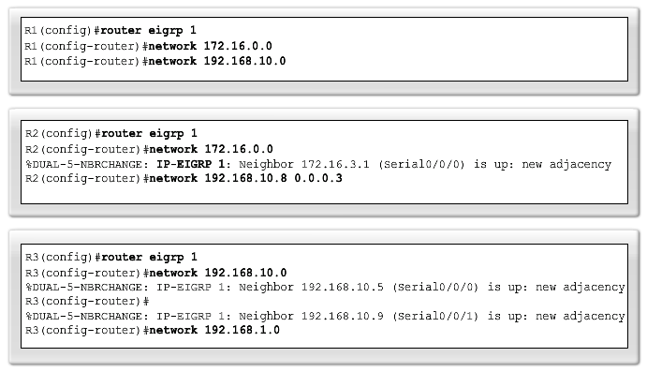
The network Command

Slide 60
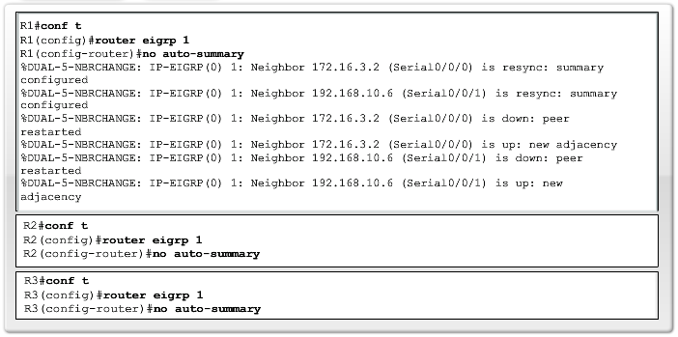
Disabling Automatic Summarization

Slide 61
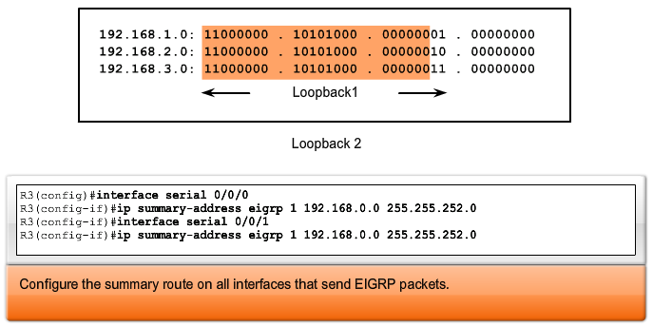
Manual Summarization

Slide 62
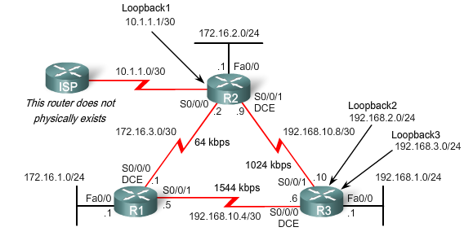

EIGRP Default Route

Slide 63
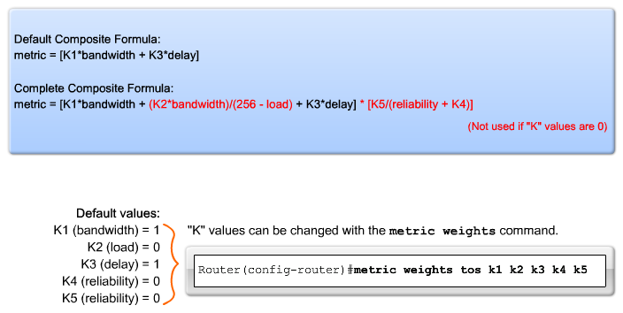
EIGRP Composite Metric

Slide 64
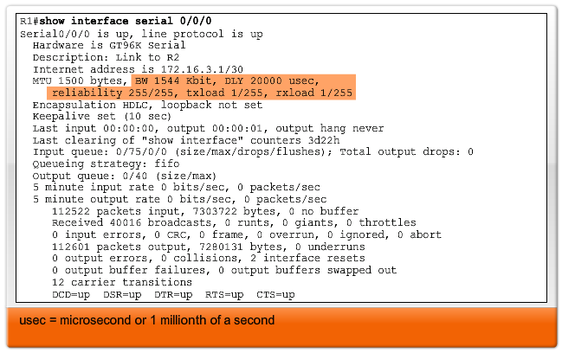
EIGRP Metrics

Slide 65
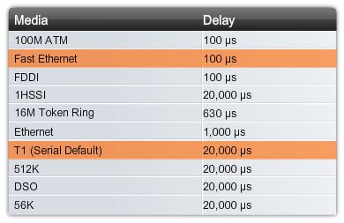
EIGRP Metrics

Slide 66
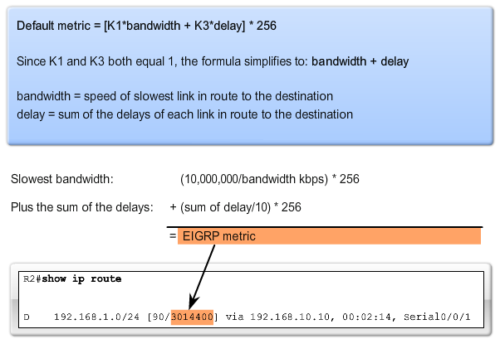
Calculating the EIGRP Metric

Slide 67
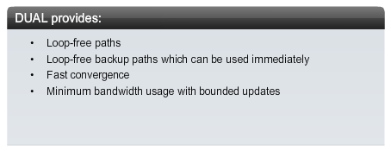
DUAL Concepts
DUAL uses several terms:
Successor
Feasible Distance (FD)
Feasible Successor (FS)
Reported Distance (RD) or Advertised Distance (AD)
Feasible Condition or Feasibility Condition (FC)

Slide 68
Successor and Feasible Distance
A successor is a neighboring router that is used for packet forwarding and is the least-cost route to the destination network. The IP address of a successor is shown in a routing table entry right after the word via
Feasible distance (FD) is the lowest calculated metric to reach the destination network. FD is the metric listed in the routing table entry as the second number inside the brackets. As with other routing protocols this is also known as the metric for the route

Slide 69
Feasible Successor
A feasible successor (FS) is a neighbor who has a loop-free backup path to the same network as the successor by satisfying the feasibility condition
In our topology, would R2 consider R1 to be a feasible successor to network 192.168.1.0/24? In order to be a feasible successor, R1 must satisfy the feasibility condition (FC)

Slide 70
Feasibility Condition
The feasibility condition (FC) is met when a neighbor's reported distance (RD) to a network is less than the local router's feasible distance to the same destination network
The reported distance or advertised distance is simply an EIGRP neighbor's feasible distance to the same destination network
The reported distance is the metric that a router reports to a neighbor about its own cost to that network

Slide 71
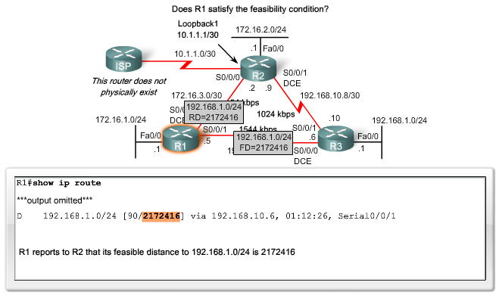
Feasibility Condition

Slide 72
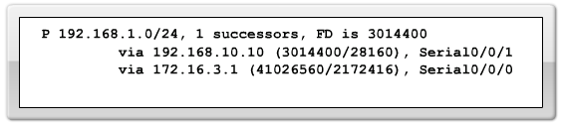
Topology Table
This shows the number of successors for this network. If there are multiple equal cost paths to this network, there will be multiple successors
This is the destination network that is also found in the routing table

Slide 73
Topology Table
This is the next-hop address of the successor
This is the feasible distance, the EIGRP metric to reach the destination network

Slide 74
Topology Table
This is the reported distance of the successor
This is the outbound interface used to reach this network, also shown in the routing table

Slide 75
Topology Table
This is the reported distance of the feasible successor or R1's metric to reach this network. This value, RD, must be less than the current FD of 3014400 to meet the feasibility condition
This is the next-hop address of the feasible successor

Slide 76
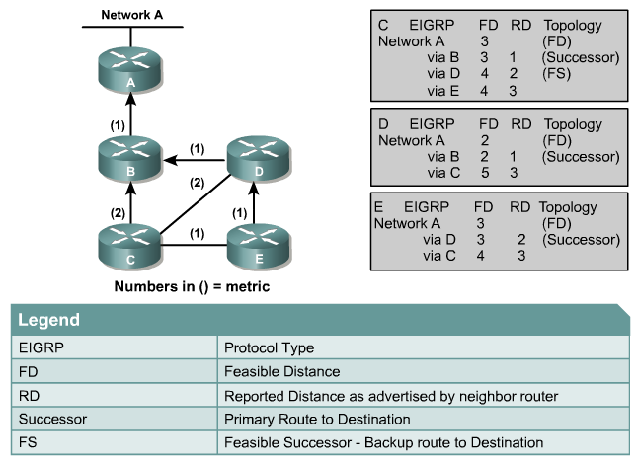
Finite State Machine

Slide 77
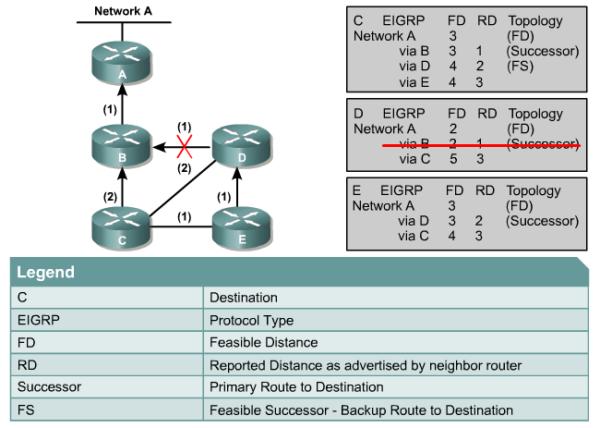
Finite State Machine

Slide 78
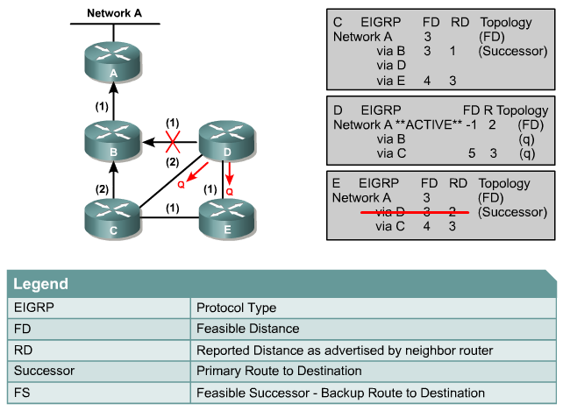
Finite State Machine

Slide 79
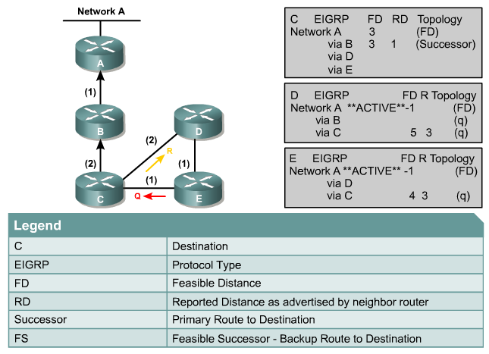
Finite State Machine

Slide 80
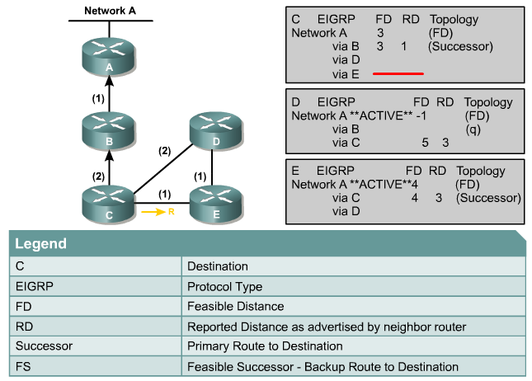
Finite State Machine

Slide 81
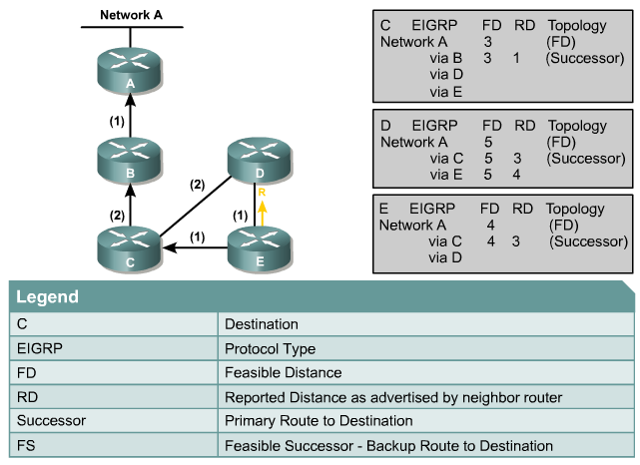
Finite State Machine

Slide 82
173
Refer to the exhibit. Which address and mask combination represents a summary of the routes learned by EIGRP?
192.168.25.0 255.255.255.240
192.168.25.0 255.255.255.252
192.168.25.16 255.255.255.240
192.168.25.16 255.255.255.252
192.168.25.28 255.255.255.240
192.168.25.28 255.255.255.252

Slide 83
174
Refer to the exhibit. Assuming that the entire network topology is shown, what is the operational status of the interfaces of R2 as indicated by the command output shown?
One interface has a problem.
Two interfaces have problems.
The interfaces are functioning correctly.
The operational status of the interfaces cannot be determined from the output shown.

Slide 84
175
Which two locations can be configured as a source for the IOS image in the boot system command? (Choose two.)
RAM
NVRAM
flash memory
HTTP server
TFTP server
Telnet server

Slide 85
176
Refer to the exhibit. Given the output for this command, if the router ID has not been manually set, what router ID will OSPF use for this router?
10.1.1.2
10.154.154.1
172.16.5.1
192.168.5.3

Slide 86
177
Refer to the exhibit. What commands must be configured on the 2950 switch and the router to allow communication between host 1 and host 2? (Choose two.)

Slide 87
177
Router(config)# interface fastethernet 0/0
Router(config-if)# ip address 192.168.1.1
255.255.255.0
Router(config-if)# no shut down
Router(config)# interface fastethernet 0/0
Router(config-if)# no shut down
Router(config)# interface fastethernet
0/0.1
Router(config-subif)# encapsulation dot1q
10
Router(config-subif)# ip address
192.168.10.1 255.255.255.0
Router(config)# interface fastethernet
0/0.2
Router(config-subif)# encapsulation dot1q
20
Router(config-subif)# ip address
192.168.20.1 255.255.255.0
Router(config)# router eigrp 100
Router(config-router)# network
192.168.10.0
Router(config-router)# network
192.168.20.0
Switch1(config)# vlan database
Switch1(config-vlan)# vtp domain XYZ
Switch1(config-vlan)# vtp server
Switch1(config)# interface fastethernet 0/1
Switch1(config-if)# switchport mode trunk
Switch1(config)# interface vlan 1
Switch1(config-if)# ip default-gateway
192.168.1.1

Slide 88
178
Which two statements describe the process identifier that is used in the command to configure OSPF on a router? (Choose two.)
Router(config)# router ospf 1
All OSPF routers in an area must have the same process ID.
Only one process number can be used on the same router.
Different process identifiers can be used to run multiple OSPF processes
The process number can be any number from 1 to 65,535.
Hello packets are sent to each neighbor to determine the processor identifier.

Slide 89
179
Refer to the exhibit. For what two reasons has the router loaded its IOS image from the location that is shown? (Choose two.)

Slide 90
179
Router1 has specific boot system commands that instruct it to load IOS from a TFTP server.
Router1 is acting as a TFTP server for other routers.
Router1 cannot locate a valid IOS image in flash memory.
Router1 defaulted to ROMMON mode and loaded the IOS image from a TFTP server.
Cisco routers will first attempt to load an image from TFTP for management purposes.

Slide 91
180
Refer to the exhibit. What can be determined about the router from the console output?
No configuration file was found in NVRAM.
No configuration file was found in flash.
No configuration file was found in the PCMCIA card.
Configuration file is normal and will load in 15 seconds.

Slide 92
181
Which three elements must be used when you configure a router interface for VLAN trunking? (Choose three.)
one physical interface for each subinterface
one IP network or subnetwork for each subinterface
a management domain for each subinterface
subinterface encapsulation identifiers that match VLAN tags
one subinterface per VLAN
subinterface numbering that matches VLAN tags

Slide 93
182
Which commands are required to properly configure a router to run OSPF and to add network 192.168.16.0/24 to OSPF area 0? (Choose two.)
Router(config)# router ospf 0
Router(config)# router ospf 1
Router(config)# router ospf area 0
Router(config-router)# network 192.168.16.0 0.0.0.255 0
Router(config-router)# network 192.168.16.0 0.0.0.255 area 0
Router(config-router)# network 192.168.16.0 255.255.255.0 area 0

Slide 94
183
A router receives information about network 192.168.10.0/24 from multiple sources. What will the router consider the most reliable information about the path to that network?
a directly connected interface with an address of 192.168.10.254/24
a static route to network 192.168.10.0/24
a RIP update for network 192.168.10.0/24
an OSPF update for network 192.168.0.0/16
a default route with a next hop address of 192.168.10.1
a static route to network 192.168.10.0/24 with a local serial interface configured as the next hop

Slide 95
184
What is the default maximum number of equal-cost paths that can be placed into the routing table of a Cisco OSPF router?
2
8
16
unlimited
default maximum number of equal-cost paths is 4
configurable maximum number of equal-cost paths is 16

Slide 96
185
Which command shows your active Telnet connections?
show cdp neigbors
show session
show users
show vty logins

Slide 97
186
Which type of EIGRP route entry describes a feasible successor?
a backup route, stored in the routing table
a primary route, stored in the routing table
a backup route, stored in the topology table
a primary route, stored in the topology table

Slide 98
187
The network administrator cannot connect to Switch1 over a Telnet session, although the hosts attached to Switch1 can ping the interface Fa0/0 of the router. Given the information in the graphic and assuming that the router and Switch2 are configured properly, which of the following commands should be issued on Switch1 to correct this problem?

Slide 99
187
Switch1(config)# line con0
Switch1(config-line)# password cisco
Switch1(config-line)#login
Switch1(config)# interface fa0/1
Switch1(config-if)# ip address 192.168.24.3 255.255.255.0
Switch1(config)# ip default-gateway 192.168.24.1
Switch1(config)# interface fa0/1
Switch1(config-if)# duplex full
Switch1(config-if)# speed 100
Switch1(config)# interface fa0/1
Switch1(config-if)# switchport mode trunk

Slide 100
188
Refer to the exhibit. Which of these statements correctly describes the state of the switch once the boot process has been completed?

Slide 101
188
As FastEthernet0/12 will be the last to come up, it will be blocked by STP.
Remote access management of this switch will not be possible without configuration change.
More VLANs will need to be created for this switch.
The switch will need a different IOS code in order to support VLANs and STP.

Slide 102
189
Two routers named Atlanta and Brevard are connected via their serial interfaces as illustrated, but they are unable to communicate. The Atlanta router is known to have the correct configuration. Given the partial configurations, identify the fault on the Brevard router that is causing the lack of connectivity.
incompatible IP address
insufficient bandwidth
incorrect subnet mask
incompatible encapsulation
link reliability too low
IPCP closed

Slide 103
190
Users on the 172.17.22.0 network cannot reach the server located on the 172.31.5.0 network. The network administrator connected to router Coffee via the console port, issued the show ip route command, and was able to ping the server. Based on the output of the show ip route command and the topology shown in the graphic, what is the cause of the failure?

Slide 104
190
The network has not fully converged.
IP routing is not enabled.
A static route is configured incorrectly.
The FastEthernet interface on Coffee is disabled.
The neighbor relationship table is not correctly updated.
The routing table on Coffee has not updated .

Slide 105
191
A network administrator is trying to add a new router into an established OSPF network. The networks attached to the new router do not appear in the routing tables of the other OSPF routers. Given the information in the partial configuration shown below, what configuration error is causing this problem?
Router(config)# router ospf 1
Router(config-router)# network 10.0.0.0 255.0.0.0 area 0
The process id is configured improperly.
The OSPF area is configured improperly.
The network wildcard mask is configured improperly.
The network number is configured improperly.
The AS is configured improperly.
The network subnet mask is configured improperly.

Slide 106
192
Which two statements about the OSPF Router ID are true? (Choose two.)
It identifies the source of a Type 1 LSA.
It should be the same on all routers in an OSPF routing instance.
By default, the lowest IP address on the router becomes the OSPF Router ID.
The router automatically chooses the IP address of a loopback as the OSPF Router ID.
It is created using the MAC Address of the loopback interface.

Slide 107
193
What are two benefits of using a single OSPF area network design? (Choose two.)
It is less CPU intensive for routers in the single area.
It reduces the types of LSAs that are generated.
It removes the need for virtual links.
It increases LSA response times.
It reduces the number of required OSPF neighbor adjacencies.

Slide 108
OSPF States
To troubleshoot OSPF, it is important to understand how OSPF routers traverse different OSPF states when adjacencies are being established
hen troubleshooting OSPF neighbors, be aware that the FULL or 2WAY states are normal

Slide 109
194
When a router undergoes the exchange protocol within OSPF, in what order does it pass through each state?
exstart state > loading state > exchange state > full state
exstart state > exchange state > loading state > full state
exstart state > full state > loading state > exchange state
loading state > exchange state > full state > exstart state

Slide 110
195
What are two enhancements that OSPFv3 supports over OSPFv2? (Choose two.)
It requires the use of ARP.
It can support multiple IPv6 subnets on a single link.
It supports up to 2 instances of OSPFv3 over a common link.
It routes over links rather than over networks.

Slide 111
196
What are two enhancements that OSPFv3 supports over OSPFv2? (Choose two.)
It requires the use of ARP.
It can support multiple IPv6 subnets on a single link.
It supports up to 2 instances of OSPFv3 over a common link.
It routes over links rather than over networks.

Slide 112
197
What command sequence will configure a router to run OSPF and add network 10.1.1.0 /24 to area 0?
router ospf area 0
network 10.1.1.0 255.255.255.0 area 0
router ospf
network 10.1.1.0 0.0.0.255
router ospf 1
network 10.1.1.0 0.0.0.255 area 0
router ospf area 0
network 10.1.1.0 0.0.0.255 area 0
router ospf
network 10.1.1.0 255.255.255.0 area 0
router ospf 1
network 10.1.1.0 0.0.0.255

Slide 113
198
Refer to the exhibit. If the router Cisco returns the given output and has not had its router ID set manually, what value will OSPF use as its router ID?
192.168.1.1
172.16.1.1
1.1.1.1
2.2.2.2

Slide 114
199
What OSPF command, when configured, will include all interfaces into area 0?
network 0.0.0.0 255.255.255.255 area 0
network 0.0.0.0 0.0.0.0 area 0
network 255.255.255.255 0.0.0.0 area 0
network all-interfaces area 0

Slide 115
200
Which statement describes the process ID that is used to run OSPF on a router?
It is globally significant and is used to represent the AS number.
It is locally significant and is used to identify an instance of the OSPF database.
It is globally significant and is used to identify OSPF stub areas.
It is locally significant and must be the same throughout an area.

